Slide 1
THE TOY ASSOCIATION OF INDIA Organizes
SOUTH EAST ASIA’S Largest Toy Fair
Toys | Games | Ride on | Sports and more…
THE 14TH TOY BIZ INTERNATIONAL B2B EXPO 2023

Slide 2
HALL NO. 5, PRAGATI MAIDAN, NEW DELHI, INDIA SATURDAY 8TH JULY – TUESDAY 11TH JULY 2023
160+ INDIAN BRANDS ON DISPLAY
100 FOREIGN BUYERS FROM 10 COUNTRIES

Slide 3
MAIN ATTRACTION
SEPARATE DESK FOR
INTERNATIONAL BUYERS
FACILITY FOR ONE-ON-ONE MEETINGS WITH INDIAN MANUFACTURERS
JOINT VENTURE OPPORTUNITIES

Slide 4
TO AND FRO AIR TRAVEL BY ECONOMY FAIR (SUBJECT TO A MAXIMUM OF INR 50,000/- PER PERSON WHICHEVER IS LESS)
COMPLIMENTARY HOTEL STAY FOR 2/3 NIGHTS AT FIVE STAR HOTEL WITHIN DELHI NCR – FREE TRANSFER FROM HOTEL TO VENUE AND BACK AT SCHEDULED INTERVALS.
THE ABOVE FACILITIES AVAILABLE FOR TWO REPRESENTATIVES FROM ONE IMPORTER/ DEALER

Slide 5
PUZZLES & BOARD GAMES | RIDE ONS, CYCLES/TRI CYCLES
TRADITIONAL TOYS | EDUCATIONAL TOYS & GAMES
BUILDING BLOCKS | INDORE & OUTDOOR GAMES
SOFT TOYS | KIDS FURNITURE
BACK TO SCHOOL | OTHER CHILDREN’S PRODUCTS
MAJOR PRODUCT
PROFILES

Slide 6
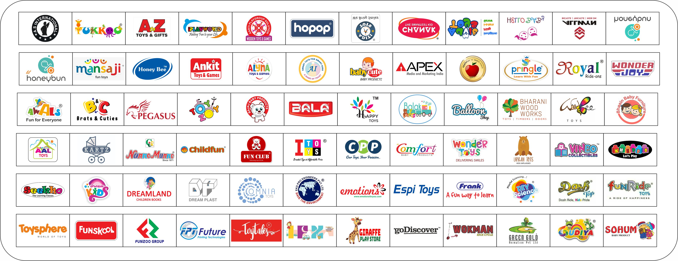
Participating Brands

Slide 7
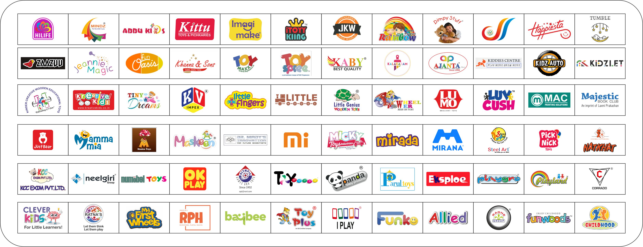
Participating Brands

Slide 8
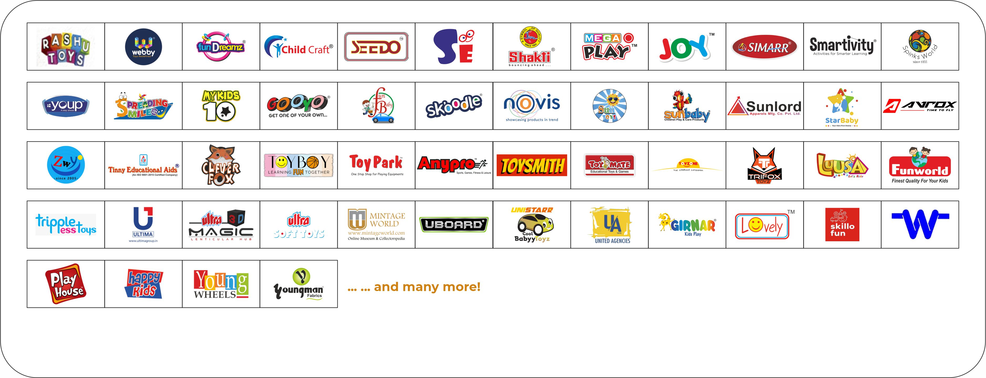
Participating Brands

Slide 9
GLIMPSES FROM 13TH TOY BIZ INTERNATIONAL B2B EXPO
2-5 JULY 2022 90+ Exhibitors 3000+ Domestic & International Buyers

Slide 10
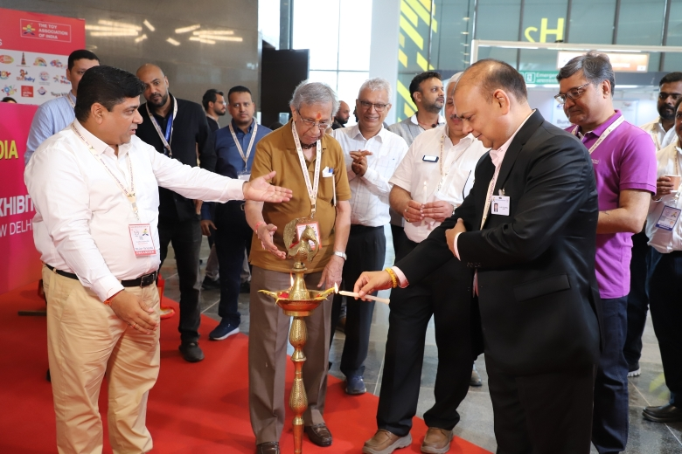
INAUGURATION

Slide 11
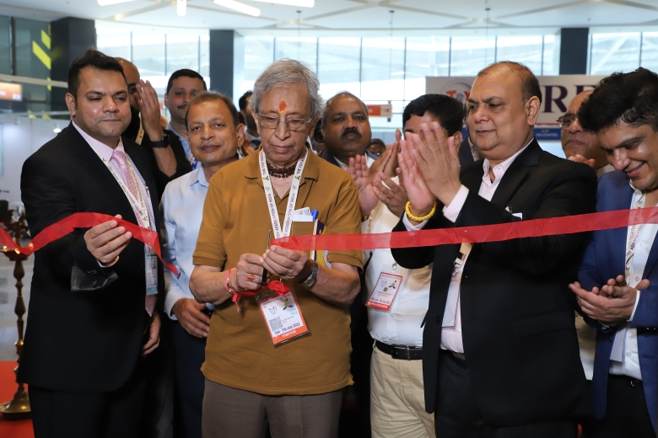

Slide 12
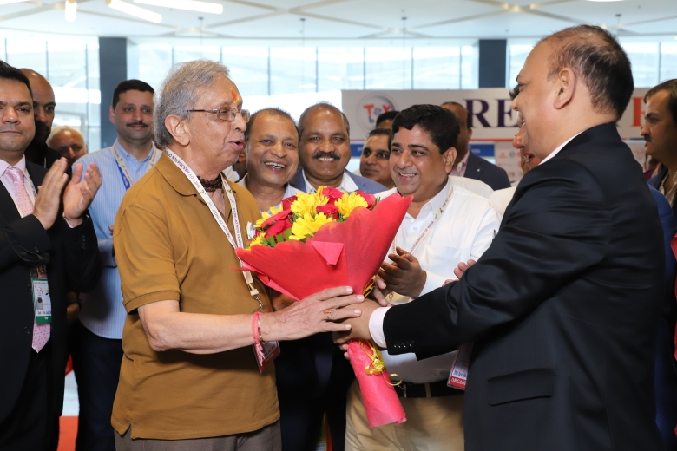

Slide 13
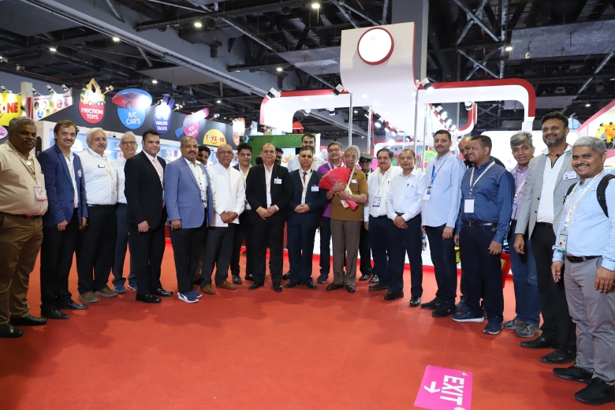

Slide 14
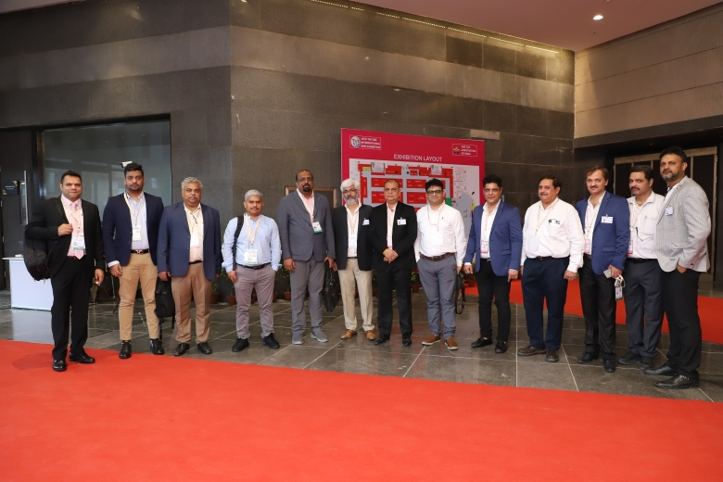

Slide 15
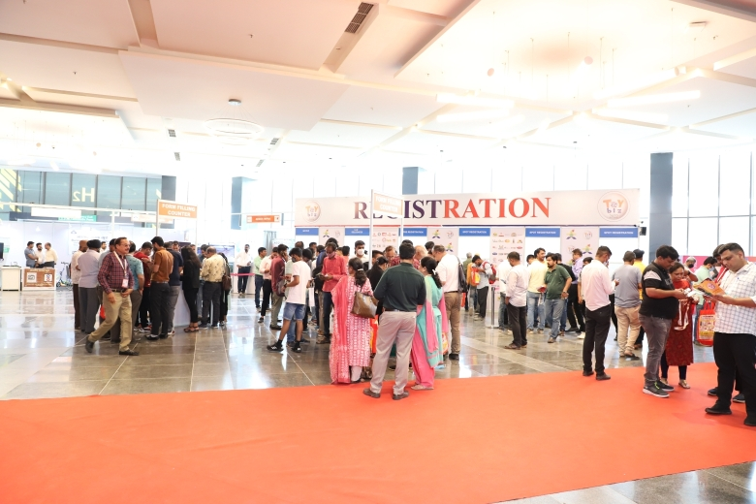

Slide 16
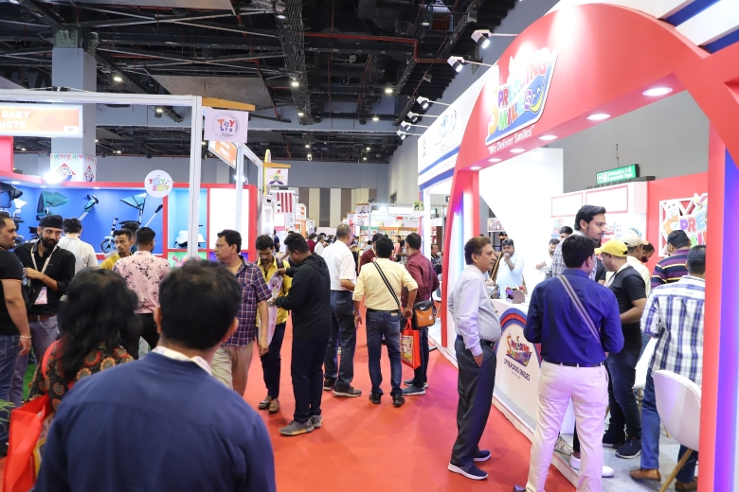

Slide 17
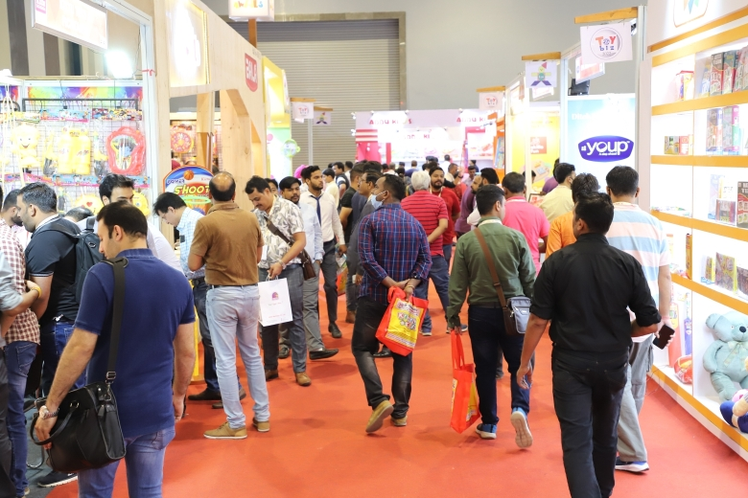

Slide 18
ALL INTERNATIONAL BUYERS ARE OUR SPECIAL GUESTS WE WILL ENSURE ALL A PLEASANT AND COMFORTABLE TIME IN INDIA

